Slide 1
Welcome
presentation topic:- Bipolar Junction Transistor(BJT)
Tanveer Ahamed Rabbi
Department of Computer Science & Engineering

Slide 2
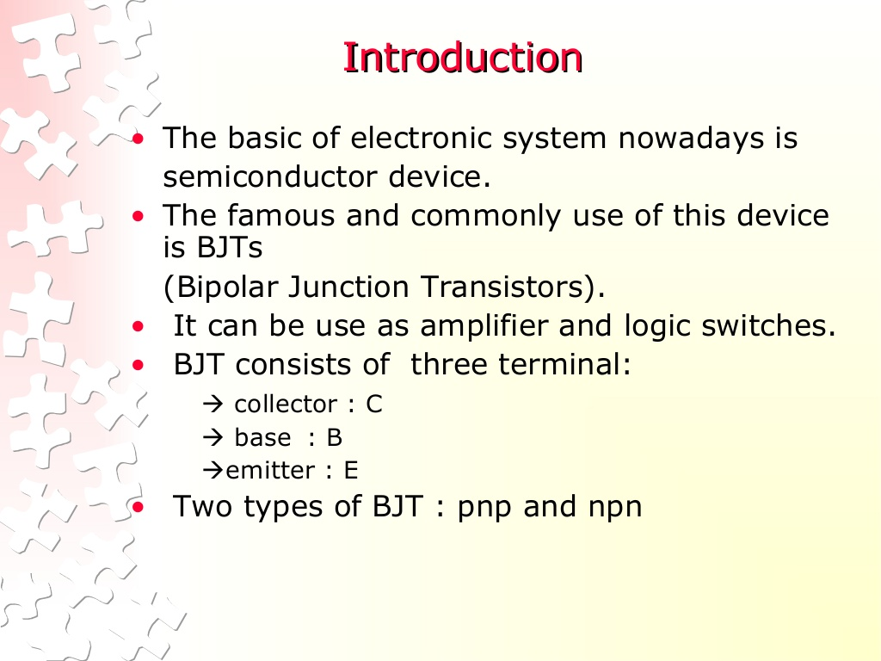

Slide 3
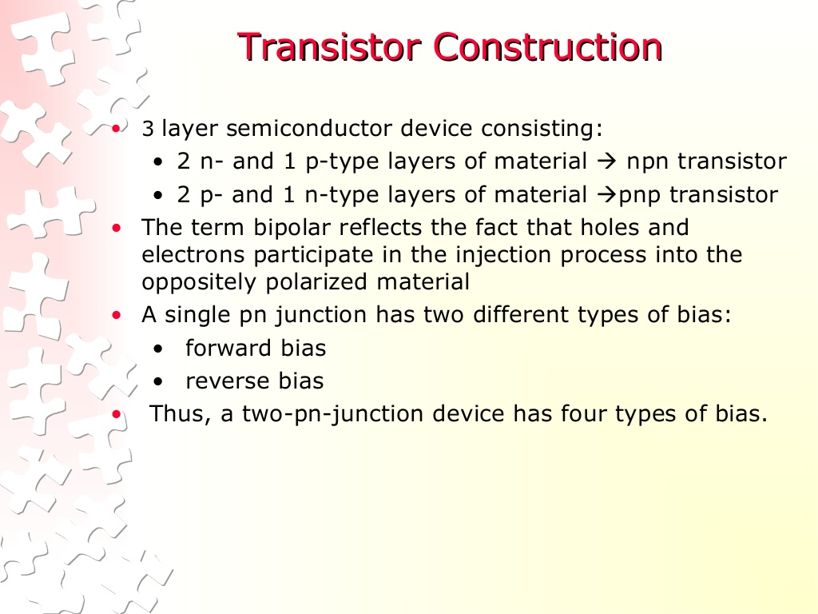

Slide 4
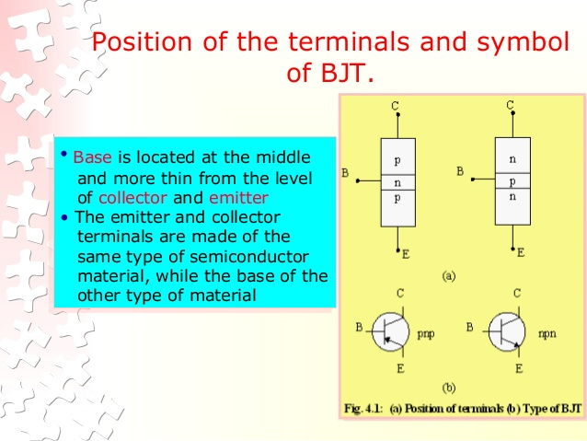

Slide 5
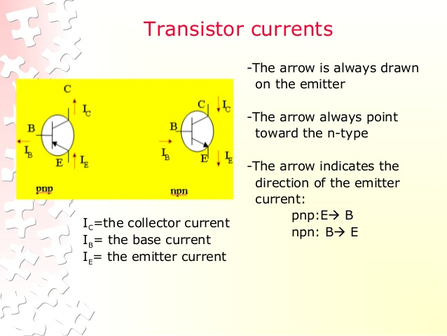

Slide 6
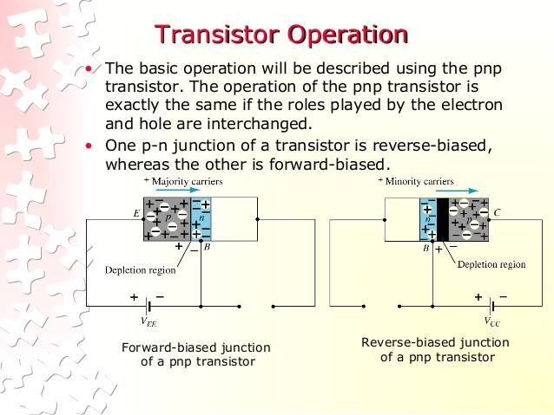

Slide 7
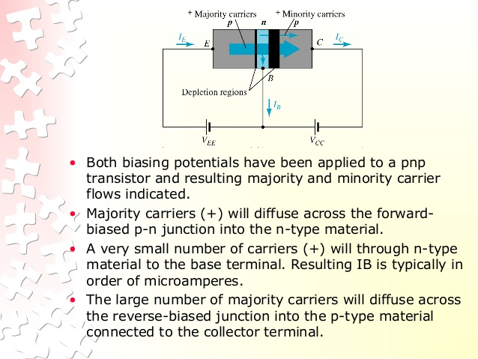

Slide 8
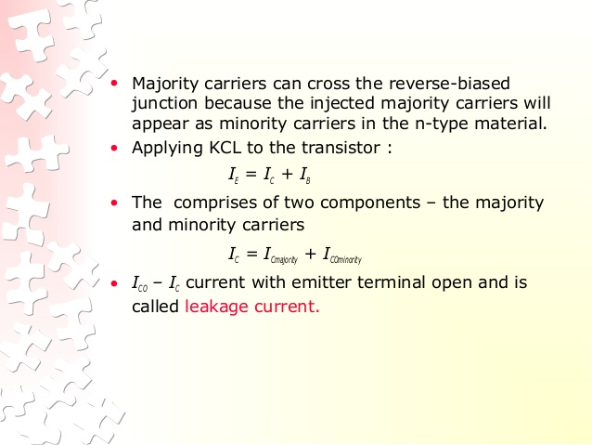

Slide 9
Thank you

